Slide 1

System Design
How to structure our program
How could the UI interact with the backend
How to make the user-Interface looks more friendly
Where can we host our application & data

Slide 2
System Design
Web Pages
(View)
Java Services
Database
3rd Party Services
Today
(article display)
users
articles
feedbacks
News Api
Models
Users
authentication
register / profile
Summarization
(Submit/ Feedback)
Restful API (Controller)
Articles
( get news / list )
History
(submission list)
OpenAI
Feedbacks
(AI Score / save )
Me
(Sign in/up/ Profile)
React + Material UI+ Vite
Spring MVC / Amazon EC2
Firestore

Slide 3
Today: Problem Statement
1: How to get news easily and stablely
Reading Rss Feeds provided by news media ?
- most of the news media stop their feeds service
- the others only provide meta data, content was not included.
Scraping news from a Website ?
- not stable
- copyright will be an issue.
Using API provided by SAAS company
newsdata.io : fit our needs.
2: How to update the news effectively
We do not need to access external service every time when users browse our app.
once we got the news from external service, we keep it in our database. The other user will get the news from our db.

Slide 4

Today : Sequence
Web Page
Restful Api
Model
DB
news Services
Access Today
api:article/latest
Article
Repository
Auth Check
request latest article
Read DB
articles
Date not match?
Get today’s article from news api
return article data
save article
save to DB
api:summary/score
Summary
Repository
summaries
Auth Check
request score
Read DB
return score data
Render Page

Slide 5
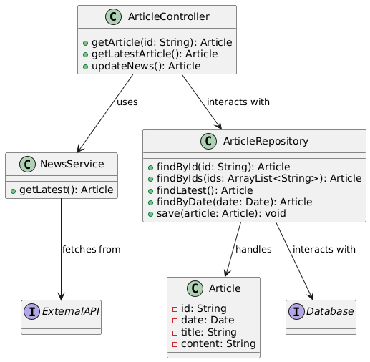
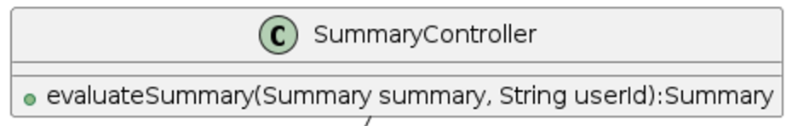
Article Service
interacts with

Slide 6
History: Problem Statement
1: How to fetch data from different collections(tables)
- loop request?
- joint table or using a view?
- batch request
2: How to paginate the data for an infinitely list
- using SQL limit *,* ?
- using cursor

Slide 7
History : Sequence
Web Page
Restful Api
Model
DB
Access /history
api:history/list
SummaryRepository
summaries
Auth Check
request latest summary
Read DB
aggregate article id list
Article
Repository
articles
request articles by id list
Read DB
aggregate history list
Render Page
return history data

Slide 8
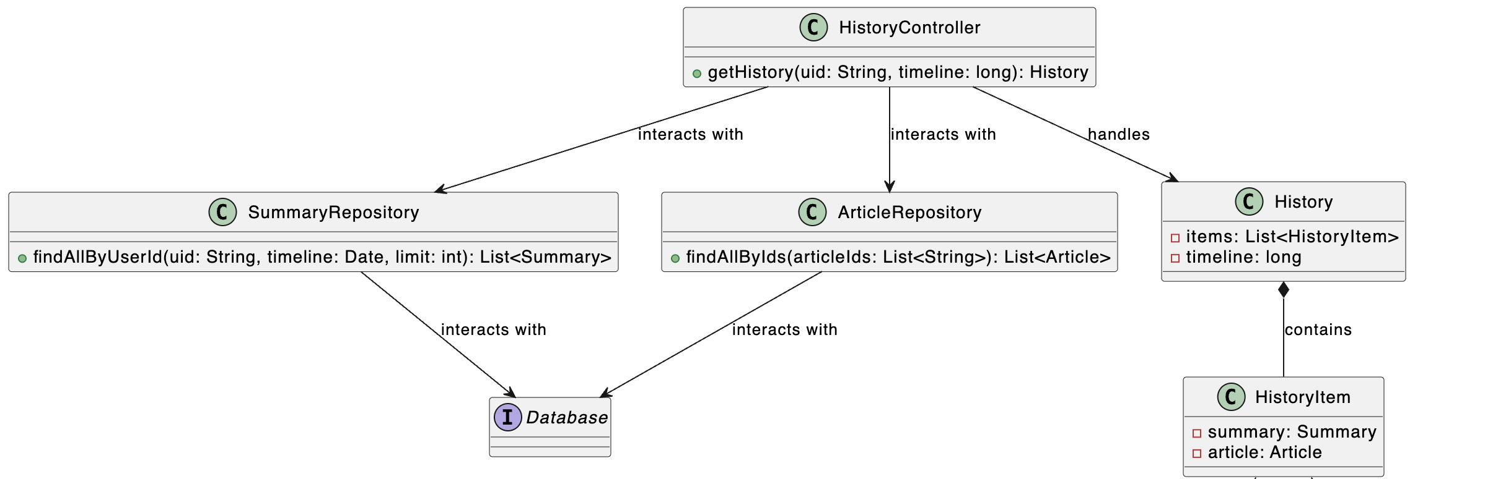
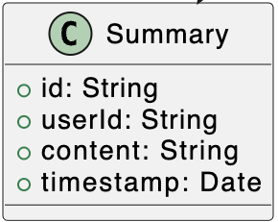
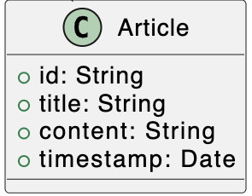
History Aggregation
handles
handles
contains
contains

Slide 9
Db design
Field Name | Type | Default Value | Property | Memo
id | String | uuid string | PrimaryKey
title | String
poster | String
content | Text
date | Datetime |  | Index | Article belong to wich date
createTime | Datetime | Current Time

